Slide 1
MACHINE LEARNING PROJECT
Under the guidance of 'Prof. Tanmay Chakraborty', Teaching Fellow 'Chhavi Mam' and Teaching Assistant 'Nirav Sir'
MEMBERS:
RISHABH BAFNA (MT20118)
VANDANA SHARMA (MT20106)
CHETAN SHARAF (MT20109)

Slide 2
FAKE JOB POSTING DETECTION
Objective : Predicting whether the jobs are real, or fake based on a suitable model and extracting information from the given dataset, i.e., getting insights from the given dataset.
Motive : To detect the fake recruiter post on the job portal which have the motive to extort money from the candidates.

Slide 3
Dataset : The dataset has been taken from Kaggle.
[Real or Fake] Fake Job Posting Prediction
Dataset of real and fake job postings
Attributes:
1. job_id
2. title
3. location
4. department
5. salary_range
6. company_profile
7. description
8. requirements
9. benefits
10. telecommunicating
11. has_company_logo
12. has_questions
13. employment_type
14. required_experience
15. required_education
16. industry
17. Function
18. fraudulent

Slide 4
The Data set contains a lot of text Description. Hence, our project is related to Natural Language Processing(NLP). And therefore, preprocessing was done accordingly.

Slide 5
PREPROCESSING OF DATA
Tokenization
HTML links removal
Removing Stopwords
Removing Punctuation Marks
Stemming, Lemmetization
Counter Vectorizer
TF-IDF

Slide 6
Model
Multinomial Naïve Bayes
Logistic Regression
Support Vector Classifier
Multilevel Perceptron Classifier
LSTM(Long Short-Term Memory)

Slide 7
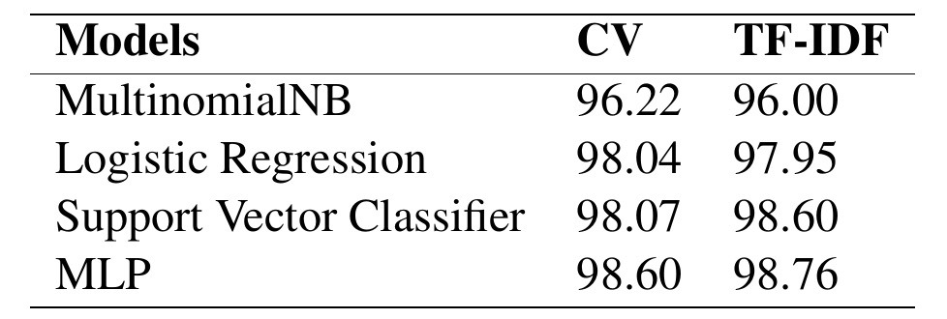
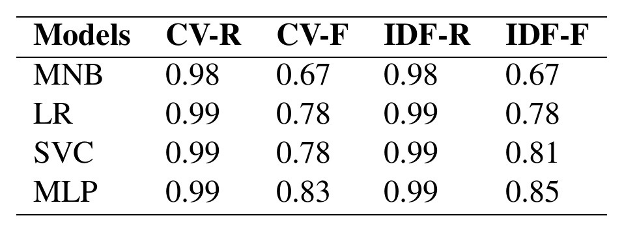
ACCURACY AND F1SCORE
LSTM
Test Loss : 0.26
Test Accuracy : 0.97
Train Loss : 0.016
Train Accuracy: 0.99
F1 Score :
Real: 0.99
Fake: 0.74

Slide 8
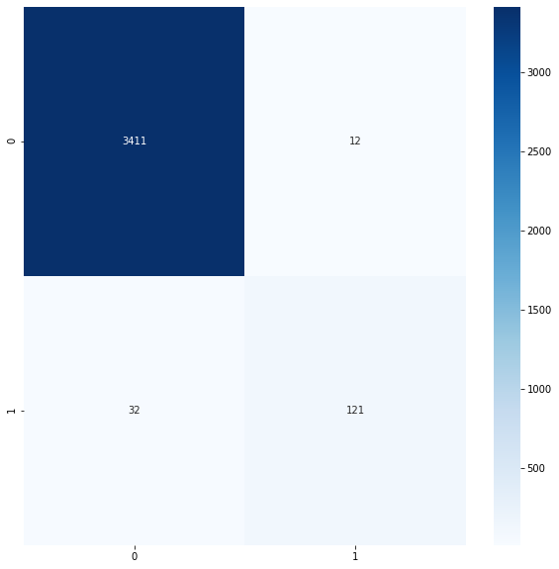
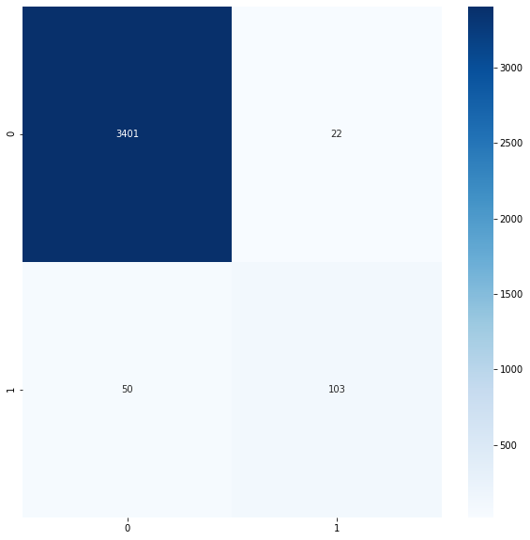
CONFUSION MATRIX
MLP
LSTM

Slide 9
References
Fake Job Recruitment Detection Using Machine Learning Approach
on Androutsopoulos, Georgios Paliouras, Vange- lis Karkaletsis, Georgios Sakkis, Constantine D. Spyropoulos, and Panagiotis Stamatopoulos. 2000. Learning to filter spam e-mail: A comparison of a naive bayesian and a memory-based approach. CoRR, cs.CL/0009009.
Shawni Dutta and Samir Kumar Bandyopadhyay. 2020.
Fake job recruitment detection using machine learn- ing approach. International Journal of Engineering Trends and Technology, 68(4):48–53.
Ibrahim M. Nasser and Amjad H. Alzaanin. 2020. Ma- chine learning and job posting classification: A com- parative study. International Journal of Engineering and Information Systems (IJEAIS), 4(9):06–14.
J. C. S. Reis, A. Correia, F. Murai, A. Veloso, and F. Benevenuto. 2019. Supervised learning for fake news detection. IEEE Intelligent Systems, 34(2):76– 81.

